Slide 1



FINAL PROJECT – Data Science Bootcamp Batch 1
1980-2016
Video Games Sales Metacritic
R Studio
Meno Triono
dibimbing.id
Notes:
Illustration:
https://www.freepik.com/free-vector/floating-group-devices_3979449.htm
https://www.freepik.com/free-vector/teamwork-characters-operator-crew-front-screen-presentations_4997765.htm

Slide 2


Timeline & History
It began as a simple idea back in the summer of 1999: a single score could summarize the many entertainment reviews available for a movie or a video game. Metacritic's three founding members—all former attorneys who were happy to find a more constructive but less profitable use of their time—launched the site in January 2001 and Metacritic has evolved over the last decade to reflect their experience distilling many critics' voices into the single Metascore, a weighted average of the most respected critics writing reviews online and in print.
2012
1980
1996
2008
2016
Dataset start from this years
This year Video Games break sales record after 15 years
Top Peak Video Games Sales All the time
4 Streak years dropping video games sales global
Video Games in this years equal to sales at 2000
Page 1

Slide 3
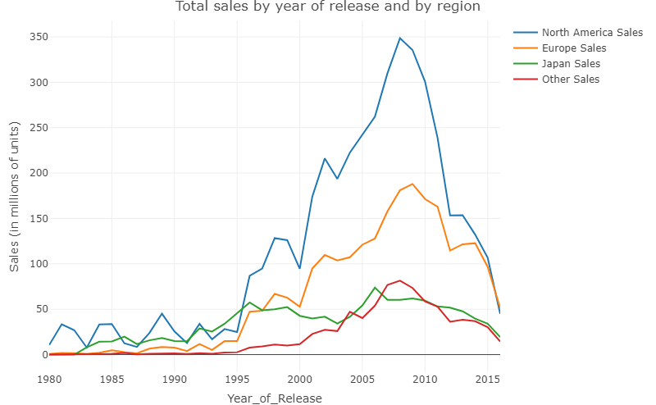

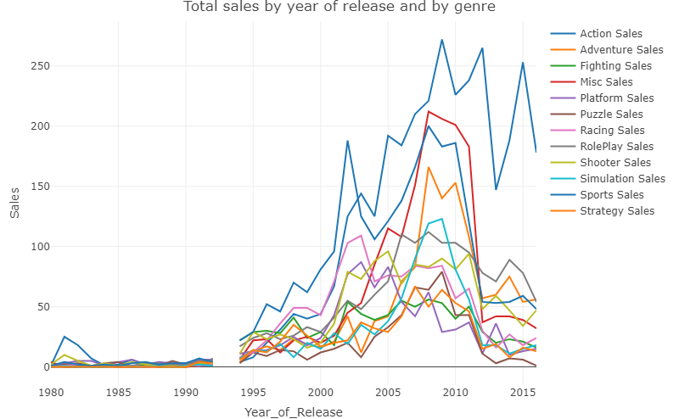

Product Sales 1980-2016
The decline in sales is not something that is expected for metacritic, because it can disrupt the ecosystem or the gamers community on metacritics.
Page 2
Notes:
Illustration:
- https://www.freepik.com/free-vector/logistics-warehouse-interior-with-worker-driving-forklift-loader-inspector-checking-list-delivered-cargo_4997783.htm

Slide 4

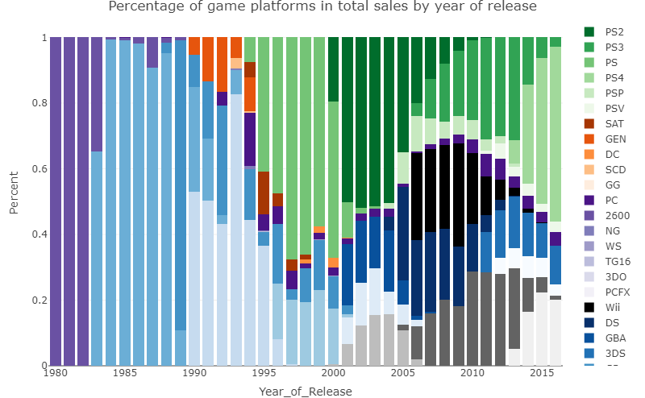
Our Mission
02.
We believe that multiple opinions are better than one, user voices can be as important as critics, and opinions must be scored to be easy to use.
03.
Our Metascore system is unique and merits its own explanation page.
Metacritic's mission is to help consumers make an informed decision about how to spend their time and money on entertainment.
01.
Page 4
Notes:
Illustration:
https://www.freepik.com/free-vector/cartoon-characters-coworking-center-creative-space-freelancers-designers-work-together_3266662.htm

Slide 5



Analytic Descriptive
Top Video Games Sales Global
1. Wii Sports 2. Super Mario Bros 3. Mario Kart Wii
As an effort to provide information to consumers and improve the community ecosystem at Metacritic seeks to explain further specifically how gamers enjoy their time to play
Top Video Games Genre
1. Action 2. Misc 3. Sports
Top Video Games Platform
1. Sony Playstation 2. Nintendo 3. Microsfoft
Top Video Games Region
1. North America 2. Europe 3. Japan
Page 5
Notes:
Illustration :
https://www.freepik.com/free-vector/teamwork-characters-operator-crew-front-screen-presentations_4997765.htm

Slide 6
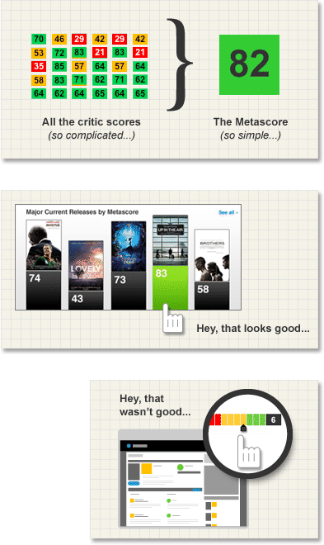
Metacritic Variable that most influences Global Sales
Critic Count 0,0221
R Square Value of 0.0221 would indicate that 2,2% of the variance of the dependent variable being studied is explained by the variance of the independent variable.
R Square Value of 0.0550 would indicate that 5,5% of the variance of the dependent variable being studied is explained by the variance of the independent variable.
Critic Score 0,0550
R Square Value of 0.0071 would indicate that 0,7% of the variance of the dependent variable being studied is explained by the variance of the independent variable.
User Count 0,0071
Page 6
Notes:
Illustration :
https://www.freepik.com/free-vector/teamwork-characters-operator-crew-front-screen-presentations_4997765.htm

Slide 7


Summary Video Games Sales
To improve the ecosystem of the gamers community in Metacritic, it is important to continue to increase Video Games Global Sales, from the data processed by supervised learning, it is known that the more critic counts, the more sales of video games globally.
This will be a formidable task as well as a mandate that must be carried out for Metacritic so that its goals can be achieved
Page
Notes:
Illustration:
https://www.freepik.com/free-vector/future-metropolis-seafront-with-illuminating-neon-colors-lights-futuristic-skyscrapers_4758668.htm
https://www.freepik.com/free-vector/teamwork-characters-operator-crew-front-screen-presentations_4997765.htm

Slide 8

Thank You!
Notes:
Illustration:
- https://www.freepik.com/free-vector/couple-riding-supermarket-shopping-cart_2238492.htm

